Slide 1
Chapter 06_05
Dynamic Programming
Optimal Binary Search Trees

Slide 2

Optimal Binary Search Trees
A binary search tree is one of the most important data structures.
An application of a binary search tree
implementing a dictionary,
A set of elements with searching, insertion, and deletion operations.
Pose a question about an optimal binary search tree:
Average number of comparisons in a search must be the smallest possible.
Minimize the average number of comparisons in a successful search.
Extend to include unsuccessful searches.

Slide 3
Example: Consider four keys A, B, C, and D to be searched for with probabilities 0.1, 0.2, 0.4 and 0.3, respectively.
key | A | B | C | D
probability | 0.1 | 0.2 | 0.3 | 0.4
0.1
A
0.2
B
0.2
B
0.1
A
0.4
C
C
0.4
D
D
0.3
0.3
Figure 6.5.1. Two out of 14 possible binary search trees containing these keys A, B, C, and D.

Slide 4
The average number of comparisons in a successful search
(i.e., the average search times for the trees):
the first tree is
0.1 *1 +0.2 * 2 + 0.4 * 3 + 0.3 * 4 = 2.9,
the second tree is
0.1 *2 +0.2 * 1 + 0.4 * 2 + 0.3 * 3 = 2.1.
Neither of these two trees is optimal.
(Then, which binary tree is optimal?)
A
0.1
B
0.2
0.4
C
0.3
0.2
D
B
0.1
0.4
A
C
0.3
D

Slide 5
0.4
C
0.2
0.3
D
B
A
0.1
The optimal number of comparisons in a successful search of these trees is:
0.4 * 1 + 0.3 * 2 + 0.2 * 2 + 0.1 * 3 = 1.7.

Slide 6
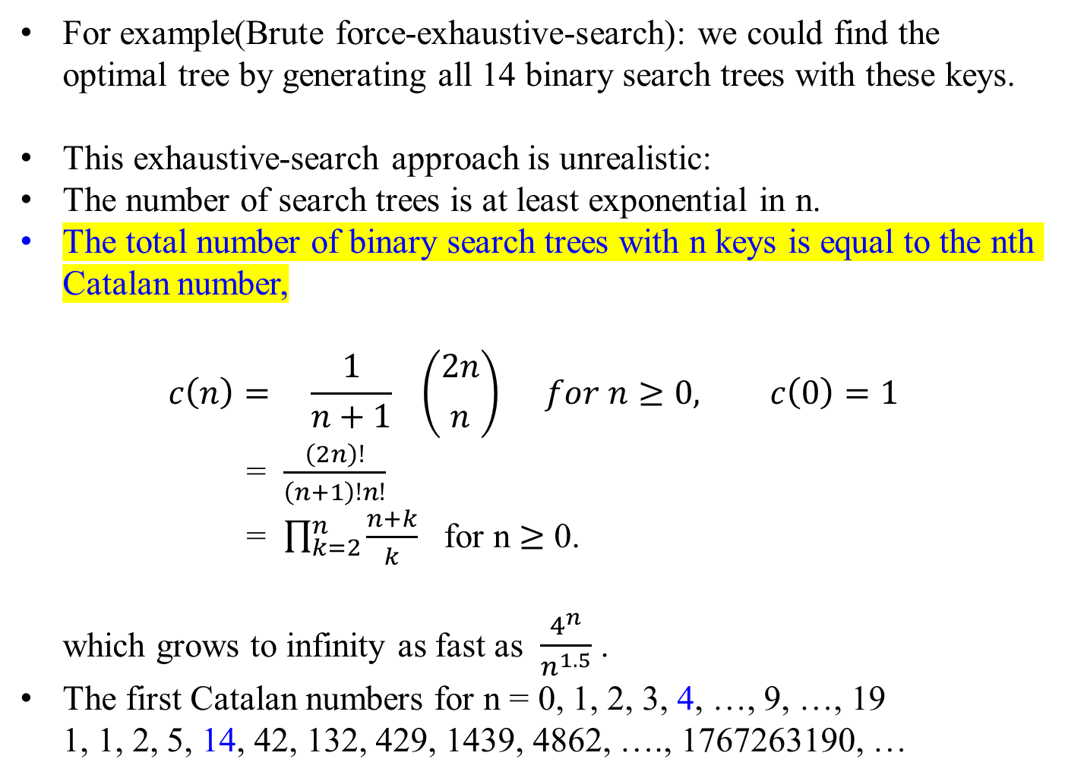
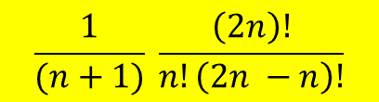
For example(Brute force-exhaustive-search): we could find the optimal tree by generating all 14 binary search trees with these keys.
This exhaustive-search approach is unrealistic:
The number of search trees is at least exponential in n.
The total number of binary search trees with n keys is equal to the nth Catalan number,
$$c\left(n\right)= \frac{1}{n+1} \left({2n \atop n}\right) for n≥0, c\left(0\right)=1$$
= $\frac{\left(2n\right)!}{\left(n+1\right)!n!}$
= $\prod_{k=2}^{n}{\frac{n+k}{k}}$ for n $≥$ 0.
which grows to infinity as fast as $\frac{4^{n}}{n^{1.5}}$.
The first Catalan numbers for n = 0, 1, 2, 3, 4, …, 9, …, 19
1, 1, 2, 5, 14, 42, 132, 429, 1439, 4862, …., 1767263190, …
$$\frac{1}{(n+1)} \frac{\left(2n\right)!}{n!\left(2n −n\right)!}$$

Slide 7
n = 0: * 1 way
n = 1: () 1 way
n = 2: ()(), (()) 2 ways
n = 3: ()()(), ()(()), (())(), (()()), ((())) 5 ways
n = 4: ()()()(), ()()(()), ()(())(), ()(()()), ()((())), 14 ways
(())()(), (())(()), (()())(), ((()))(), (()()()),
(()(())), ((())()), ((()())), (((())))
n = 5: ()()()()(), ()()()(()), ()()(())(), ()()(()()), ()()((())), 42 ways
()(())()(), ()(())(()), ()(()())(), ()((()))(), ()(()()()),
()(()(())), ()((())()), ()((()())), ()(((()))), (())()()(),
(())()(()), (())(())(), (())(()()), (())((())), (()())()(),
(()())(()), ((()))()(), ((()))(()), (()()())(), (()(()))(),
((())())(), ((()()))(), (((())))(), (()()()()), (()()(())),
(()(())()), (()(()())), (()((()))), ((())()()), ((())(())),
((()())()), (((()))()), ((()()())), ((()(()))), (((())())),
(((()()))), ((((()))))
Table 1: Balanced Parentheses

Slide 8
Binary Trees
A rooted binary tree is a binary tree with
a special node (the root) and two branches for each internal node and
zero branch for the leaf nodes.
Internal nodes are the ones that connect to two nodes below.
The Catalan numbers can count the number of rooted binary trees with n internal nodes.
Illustrated in Figure 6.5.2 are the trees corresponding to 0 ≤ n ≤ 3.
There are 1, 1, 2, and 5 of them with the internal nodes n = 0, 1, 2, and 3 respectively.
Try to draw the 14 trees with n = 4 internal nodes.
0 internal node 1 internal node 2 internal nodes
n = 3 internal nodes
Figure 6.5.2. Binary Trees

Slide 9
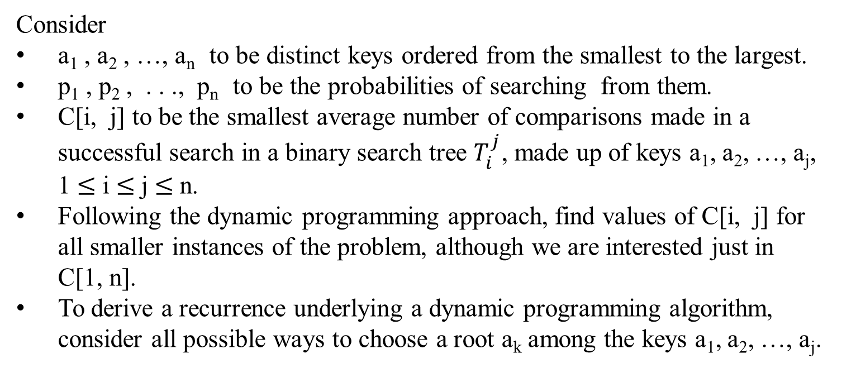
Consider
a₁ , a₂ , …, a_{n} to be distinct keys ordered from the smallest to the largest.
p₁ , p₂ , . . ., p_{n} to be the probabilities of searching from them.
C[i, j] to be the smallest average number of comparisons made in a successful search in a binary search tree $T_{i}^{j}$, made up of keys a₁, a₂, …, a_{j}, 1 $≤$ i $≤$j $≤$n.
Following the dynamic programming approach, find values of C[i, j] for all smaller instances of the problem, although we are interested just in C[1, n].
To derive a recurrence underlying a dynamic programming algorithm, consider all possible ways to choose a root a_{k} among the keys a₁, a₂, …, a_{j}.

Slide 10
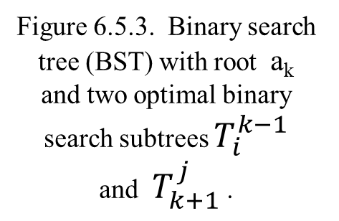
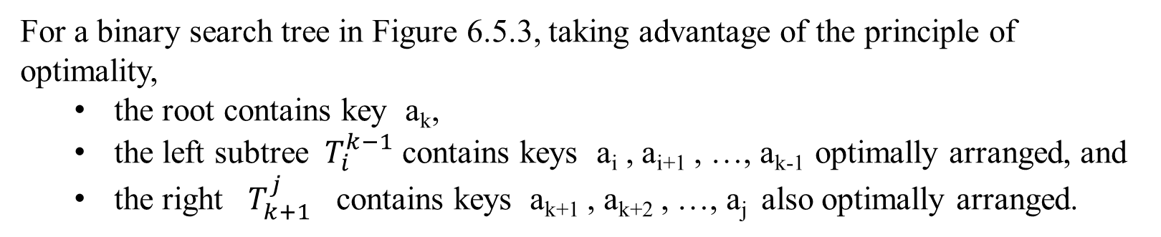


For a binary search tree in Figure 6.5.3, taking advantage of the principle of optimality,
the root contains key a_{k},
the left subtree $T_{i}^{k−1}$ contains keys a_{i} , a_{i+1} , …, a_{k-1} optimally arranged, and
the right $T_{k+1}^{j}$ contains keys a_{k+1} , a_{k+2} , …, a_{j} also optimally arranged.
For each key, there is one additional comparison at the root
a_{k}
Average search time in this subtree is C[k+1, j]
Average search time in this subtree is C[1, k-1]
Optimal BST for a_{k+1} , a_{k+2} , …, a_{j}
Optimal BST for
a_{i} , a_{i+1} , …, a_{k-1}
$$T_{k+1}^{j}$$
Figure 6.5.3. Binary search tree (BST) with root a_{k} and two optimal binary search subtrees $T_{i}^{k−1}$ and $T_{k+1}^{j}$ .
$$T_{i}^{k−1}$$

Slide 11
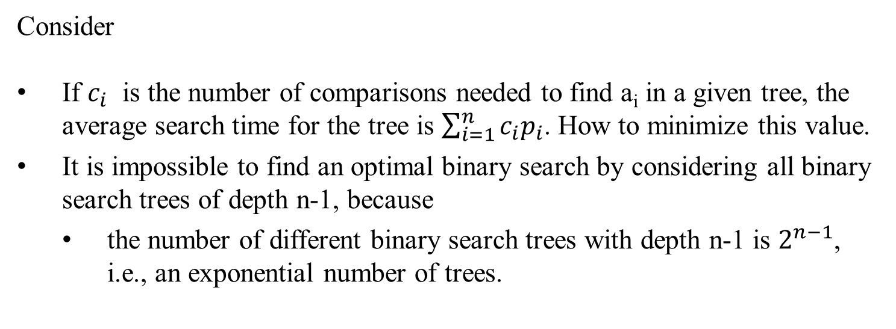
Consider
If $c_{i}$ is the number of comparisons needed to find a_{i} in a given tree, the average search time for the tree is $\sum_{i=1}^{n}{c_{i}p_{i}}$. How to minimize this value.
It is impossible to find an optimal binary search by considering all binary search trees of depth n-1, because
the number of different binary search trees with depth n-1 is $2^{n−1}$, i.e., an exponential number of trees.

Slide 12
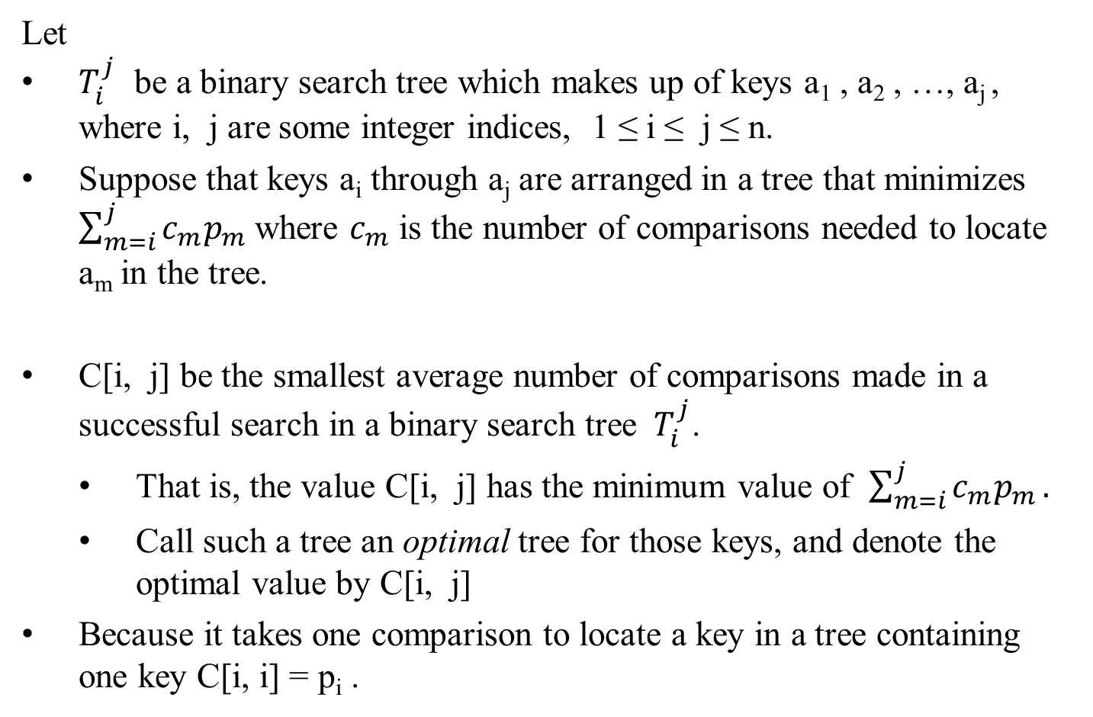
Let
$T_{i}^{j}$ be a binary search tree which makes up of keys a₁ , a₂ , …, a_{j} , where i, j are some integer indices, 1 ≤ i ≤ j ≤ n.
Suppose that keys a_{i} through a_{j} are arranged in a tree that minimizes $\sum_{m=i}^{j}{c_{m}p_{m}}$ where $c_{m}$ is the number of comparisons needed to locate a_{m} in the tree.
C[i, j] be the smallest average number of comparisons made in a successful search in a binary search tree $T_{i}^{j}$.
That is, the value C[i, j] has the minimum value of $\sum_{m=i}^{j}{c_{m}p_{m}}.$
Call such a tree an optimal tree for those keys, and denote the optimal value by C[i, j]
Because it takes one comparison to locate a key in a tree containing one key C[i, i] = p_{i} .

Slide 13
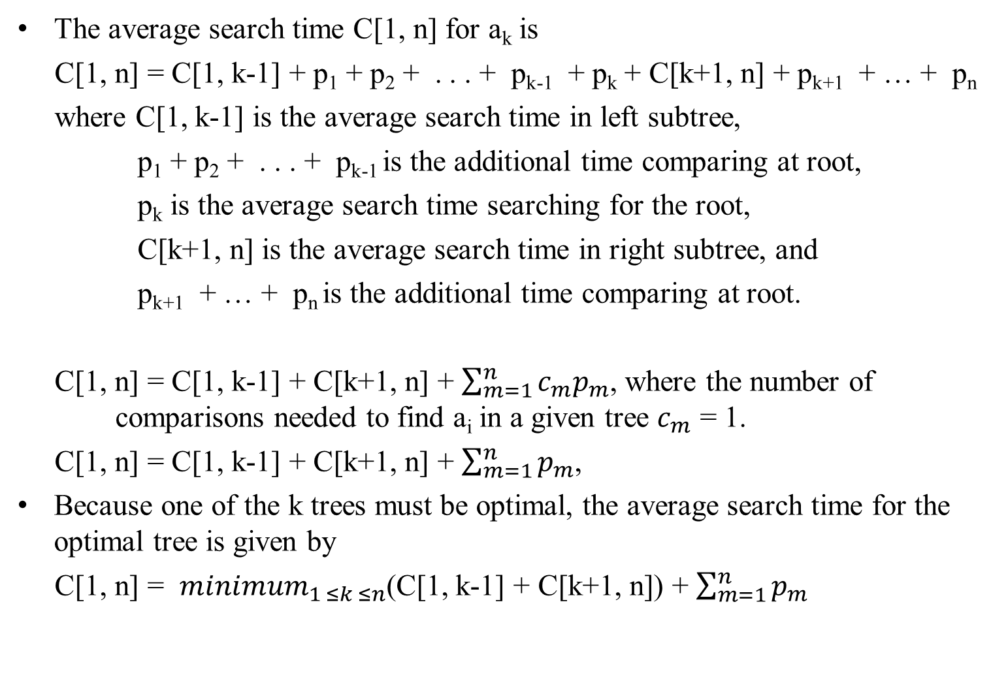
The average search time C[1, n] for a_{k} is
C[1, n] = C[1, k-1] + p₁ + p₂ + . . . + p_{k-1} + p_{k} + C[k+1, n] + p_{k+1} + … + p_{n}
where C[1, k-1] is the average search time in left subtree,
p₁ + p₂ + . . . + p_{k-1} is the additional time comparing at root,
p_{k} is the average search time searching for the root,
C[k+1, n] is the average search time in right subtree, and
p_{k+1} + … + p_{n} is the additional time comparing at root.
C[1, n] = C[1, k-1] + C[k+1, n] + $\sum_{m=1}^{n}{c_{m}p_{m}}$, where the number of comparisons needed to find a_{i} in a given tree $c_{m}$ = 1.
C[1, n] = C[1, k-1] + C[k+1, n] + $\sum_{m=1}^{n}{p_{m}}$,
Because one of the k trees must be optimal, the average search time for the optimal tree is given by
C[1, n] = ${minimum}_{1 ≤k ≤n}$(C[1, k-1] + C[k+1, n]) + $\sum_{m=1}^{n}{p_{m}}$

Slide 14
Recalled
Following the dynamic programming approach,
find values of C[i, j] for all smaller instances of the problem, although we are interested just in C[1, n].
To derive a recurrence underlying a dynamic programming algorithm,
consider all possible ways to choose a root a_{k} among the keys a₁, a₂ , …, a_{j} .

Slide 15
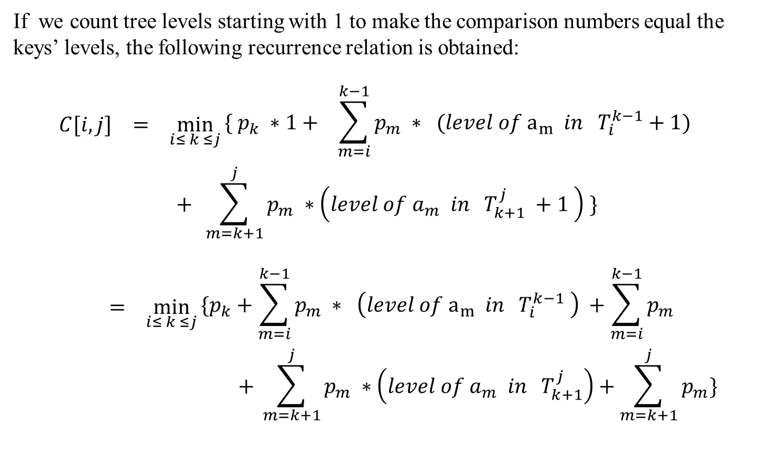
If we count tree levels starting with 1 to make the comparison numbers equal the keys’ levels, the following recurrence relation is obtained:
$$C[i, j] = \min_{i≤ k ≤j}{\begin{aligned}\{ p_{k} ∗1+ \sum_{m=i}^{k−1}{p_{m}} ∗ (level of a_{m} in T_{i}^{k−1}+1) \\ \end{aligned}}$$
$$+ \sum_{m=k+1}^{j}{p_{m}} ∗\left(level of a_{m} in T_{k+1}^{j} +1 \right) \}$$
$$= \min_{i≤ k ≤j}{\begin{aligned}\{p_{k}+\sum_{m=i}^{k−1}{p_{m}} ∗ \left(level of a_{m} in T_{i}^{k−1} \right) +\sum_{m=i}^{k−1}{p_{m}} \\ \end{aligned}}$$
$$+ \sum_{m=k+1}^{j}{p_{m}} ∗\left(level of a_{m} in T_{k+1}^{j}\right)+\sum_{m=k+1}^{j}{p_{m}}\}$$

Slide 16
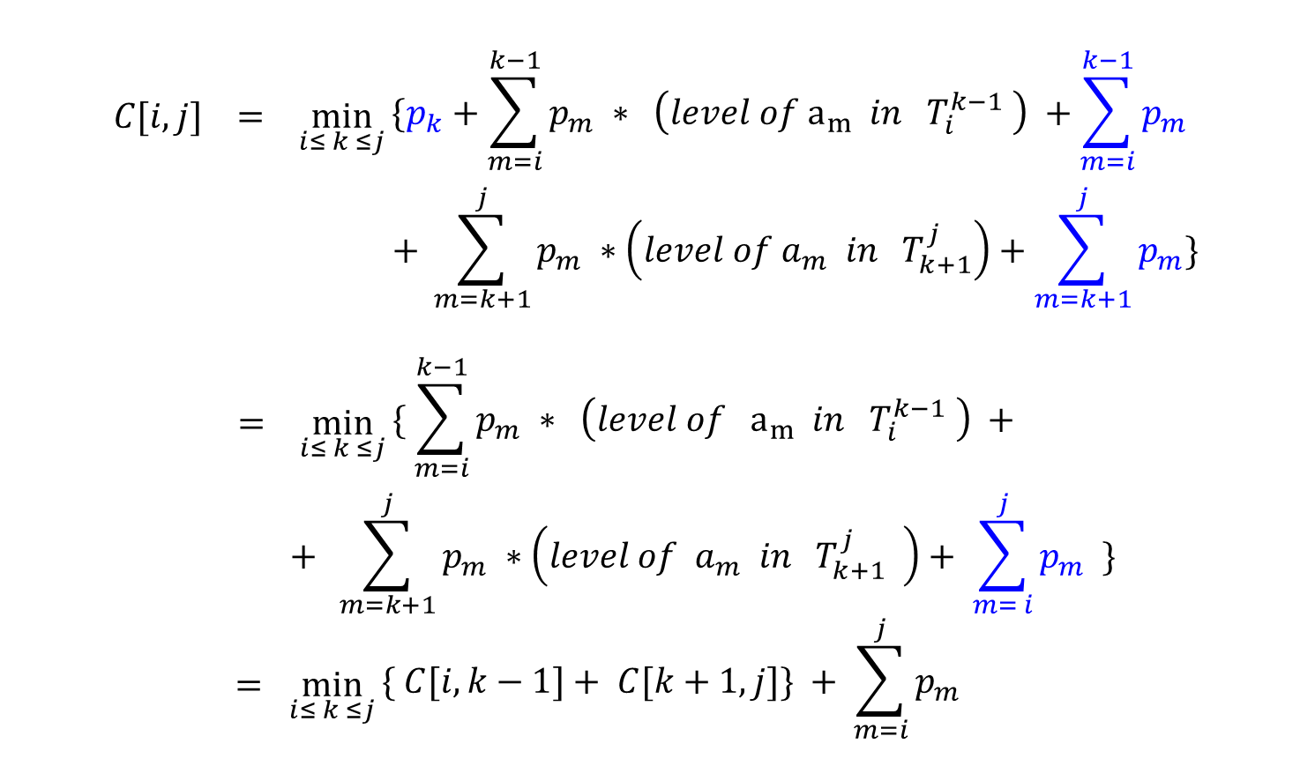
$$C[i, j] = \min_{i≤ k ≤j}{\begin{aligned}\{p_{k}+\sum_{m=i}^{k−1}{p_{m}} ∗ \left(level of a_{m} in T_{i}^{k−1} \right) +\sum_{m=i}^{k−1}{p_{m}} \\ \end{aligned}}$$
$$+ \sum_{m=k+1}^{j}{p_{m}} ∗\left(level of a_{m} in T_{k+1}^{j}\right)+\sum_{m=k+1}^{j}{p_{m}}\}$$
$$= \min_{i≤ k ≤j}{\begin{aligned}\{ \sum_{m=i}^{k−1}{p_{m}} ∗ \left(level of a_{m} in T_{i}^{k−1} \right) + \\ \end{aligned}}$$
$$+ \sum_{m=k+1}^{j}{p_{m}} ∗\left(level of a_{m} in T_{k+1}^{j} \right)+ \sum_{m= i}^{j}{p_{m}} \}$$
$$= \min_{i≤ k ≤j}{\begin{aligned}\{ C[i, k−1]+ C[k+1, j]\} + \sum_{m=i}^{j}{p_{m}} \\ \end{aligned}}$$

Slide 17
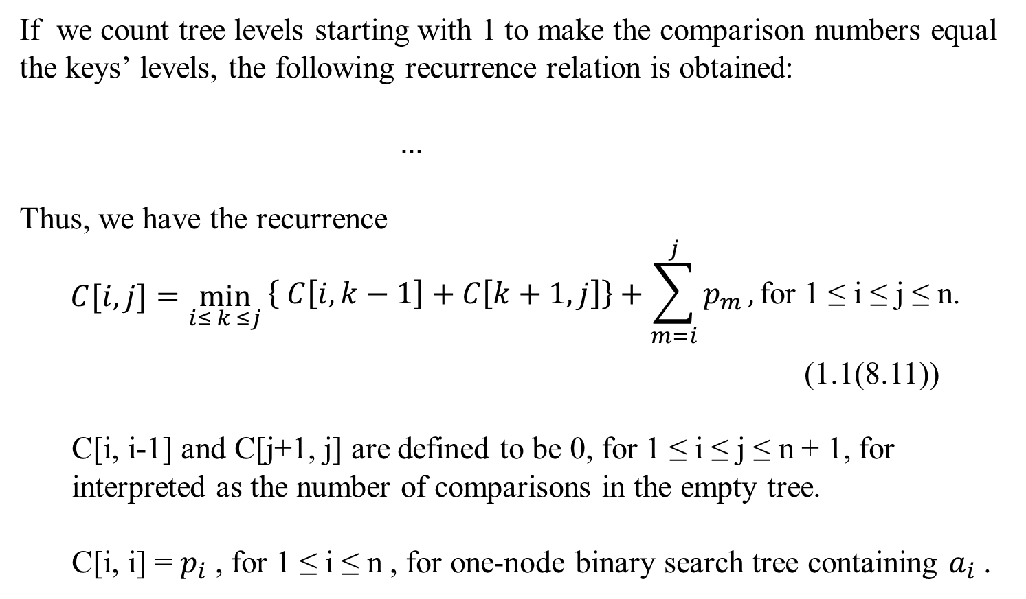
If we count tree levels starting with 1 to make the comparison numbers equal the keys’ levels, the following recurrence relation is obtained:
$$…$$
Thus, we have the recurrence
$$C[i, j]=\min_{i≤ k ≤j}{\begin{aligned}\left\{ C\left[i, k−1\right]+C\left[k+1, j\right]\right\}+\sum_{m=i}^{j}{p_{m}},\text{for}\text{ 1 }\text{≤} \text{i} \text{≤} \text{j} \text{≤} \text{n}\text{.} \\ \end{aligned}}$$
(1.1(8.11))
C[i, i-1] and C[j+1, j] are defined to be 0, for $\text{1 }\text{≤} \text{i} \text{≤} \text{j} \text{≤} \text{n}$ + 1, for interpreted as the number of comparisons in the empty tree.
C[i, i] = $p_{i}$ , for $\text{1 }\text{≤} \text{i} \text{≤} \text{n}$ , for one-node binary search tree containing $a_{i}$ .

Slide 18
 | 0 | 1 |  |  |  |  | j | n
1 | 0 | p₁ |  |  |  |  |  | goal
2 |  | 0 | p₂
i |  |  |  |  |  |  | C[i,j]
 |  |  |  |  |  |  |  | p_{n}
n+1 |  |  |  |  |  |  |  | 0
Figure 6.5.4. Table of the dynamic programming algorithm for constructing an optimal binary search tree.

Slide 19
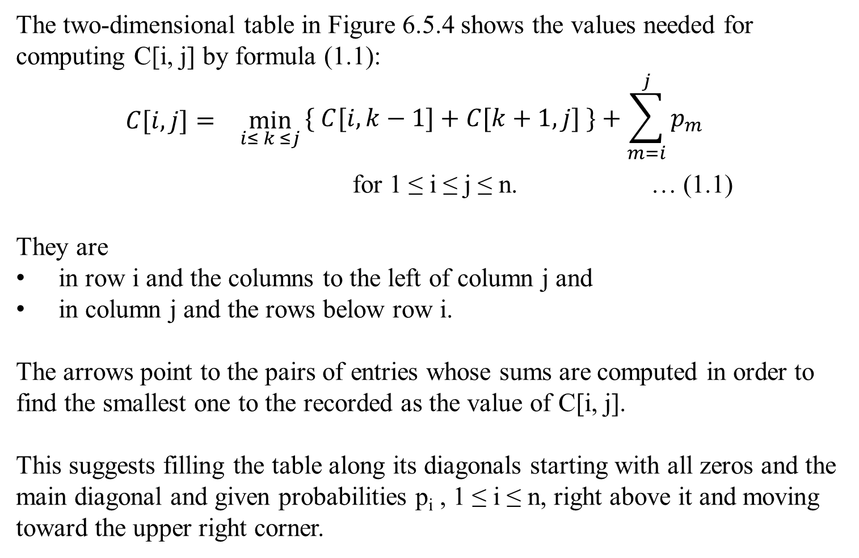
The two-dimensional table in Figure 6.5.4 shows the values needed for computing C[i, j] by formula (1.1):
$$C[i, j]= \min_{i≤ k ≤j}{\begin{aligned}\{ C[i, k−1]+C[k+1,j] \}+\sum_{m=i}^{j}{p_{m}} \\ \end{aligned}}$$
for 1 ≤ i ≤ j ≤ n. … (1.1)
They are
in row i and the columns to the left of column j and
in column j and the rows below row i.
The arrows point to the pairs of entries whose sums are computed in order to find the smallest one to the recorded as the value of C[i, j].
This suggests filling the table along its diagonals starting with all zeros and the main diagonal and given probabilities p_{i} , 1 ≤ i ≤ n, right above it and moving toward the upper right corner.

Slide 20
The sketched algorithm computes C[1, n] – the average number of comparisons for successful searches in the optimal binary tree.
For getting the optimal tree itself, this needs to maintain another two-dimensional table to record the value of k for which the minimum in (1.1) is achieved.
The table has the same shape as the table in Figure 6.5.4 and is filled in the same manner, starting with entries R[i, i] = i for 1 ≤ i ≤ n.
When the table is filled, its entries indicate indices of the roots of the optimal subtrees, which makes it possible to reconstruct an optimal tree for the entire set given.

Slide 21
Example Let illustrate the algorithm by applying it to the four-key set we used at the beginning of this section:
Key | A | B | C | D
Probability | 0.1 | 0.2 | 0.4 | 0.3
The initial tables look like this:
 | main table C
 | 0 | 1 | 2 | 3 | 4
1 | 0 | 0.1
2 |  | 0 | 0.2
3 |  |  | 0 | 0.4
4 |  |  |  | 0 | 0.3
5 |  |  |  |  | 0
 | root table R
 | 0 | 1 | 2 | 3 | 4
1 |  | 1
2 |  |  | 2
3 |  |  |  | 3
4 |  |  |  |  | 4
5

Slide 22
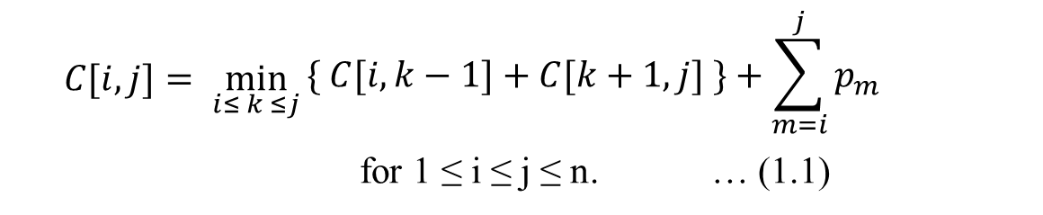
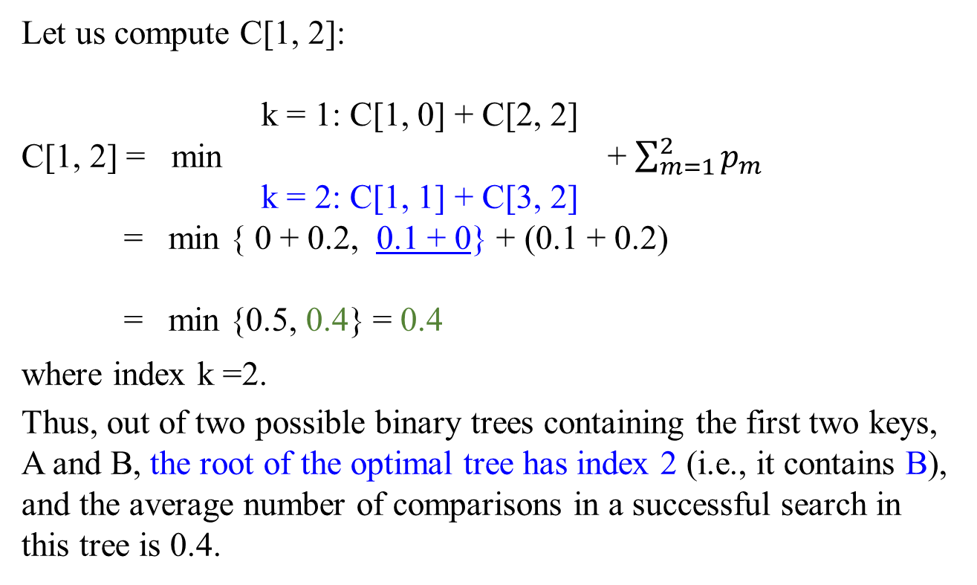
$$C[i, j]= \min_{i≤ k ≤j}{\begin{aligned}\{ C[i, k−1]+C[k+1,j] \}+\sum_{m=i}^{j}{p_{m}} \\ \end{aligned}}$$
for 1 ≤ i ≤ j ≤ n. … (1.1)
 | main table C
 | 0 | 1 | 2 | 3 | 4
1 | 0 | 0.1 | 0.4
2 |  | 0 | 0.2
3 |  |  | 0 | 0.4
4 |  |  |  | 0 | 0.3
5 |  |  |  |  | 0
Let us compute C[1, 2]:
k = 1: C[1, 0] + C[2, 2]
C[1, 2] = min + $\sum_{m=1}^{2}{p_{m}}$
k = 2: C[1, 1] + C[3, 2]
= min { 0 + 0.2, 0.1 + 0} + (0.1 + 0.2)
= min {0.5, 0.4} = 0.4
where index k =2.
Thus, out of two possible binary trees containing the first two keys, A and B, the root of the optimal tree has index 2 (i.e., it contains B), and the average number of comparisons in a successful search in this tree is 0.4.
B
1*0.2 + 2*0.1 = 0.4, or 0.1 + 0 + 0.3 = 0.4 …(1.1)
k =1 k = 2 p₁ + p₁
A
A
B
1*0.1 + 2*0.2 = 0.5, or
0 + 0.2 + 0.3 = 0.5 …(1.1)
Key | A | B | C | D
Probability | 0.1 | 0.2 | 0.4 | 0.3

Slide 23
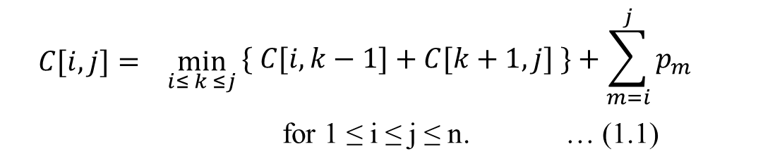
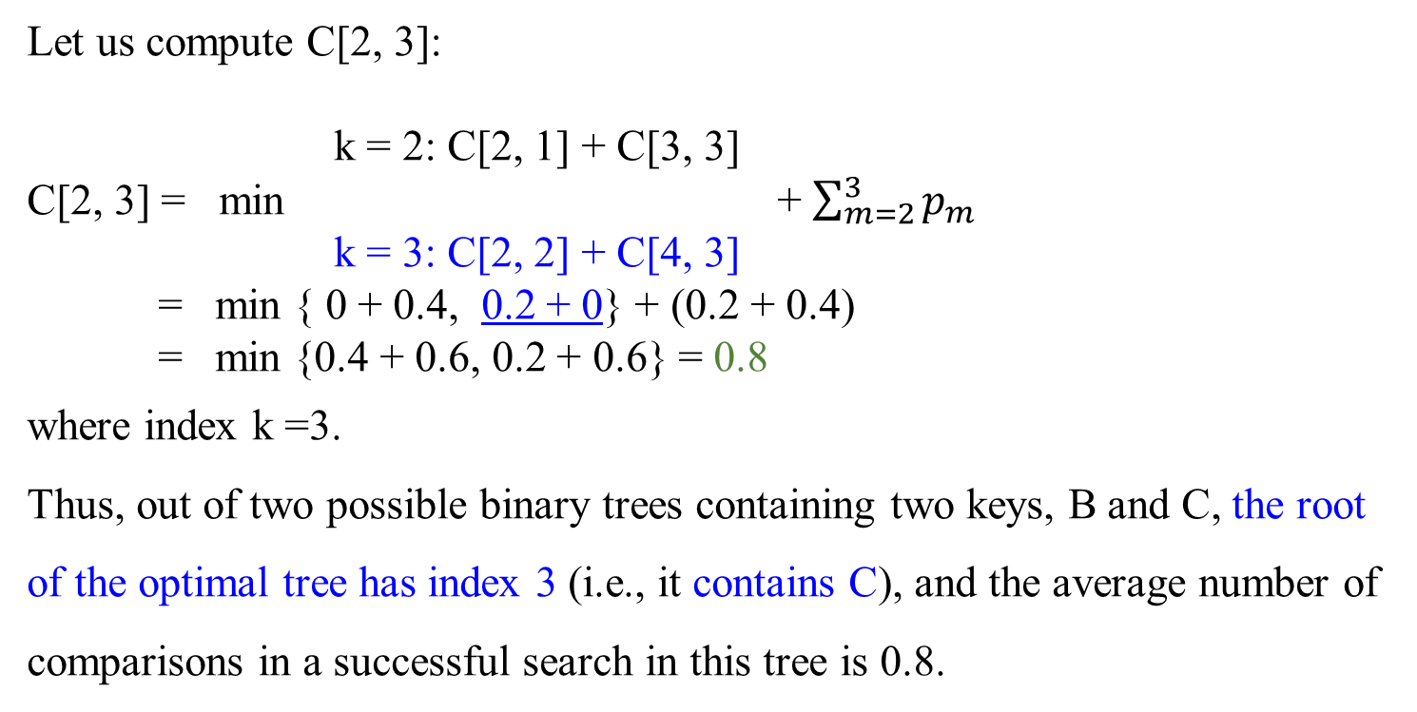
$$C[i, j]= \min_{i≤ k ≤j}{\begin{aligned}\{ C[i, k−1]+C[k+1,j] \}+\sum_{m=i}^{j}{p_{m}} \\ \end{aligned}}$$
for 1 ≤ i ≤ j ≤ n. … (1.1)
 | main table C
 | 0 | 1 | 2 | 3 | 4
1 | 0 | 0.1 | 0.4
2 |  | 0 | 0.2 | 0.8
3 |  |  | 0 | 0.4
4 |  |  |  | 0 | 0.3
5 |  |  |  |  | 0
1*0.2 + 2*0.4 = 1.0, or 0 + 0.4 + (0.2 + 0.4) = 1.0 …(1.1)
Let us compute C[2, 3]:
k = 2: C[2, 1] + C[3, 3]
C[2, 3] = min + $\sum_{m=2}^{3}{p_{m}}$
k = 3: C[2, 2] + C[4, 3]
= min { 0 + 0.4, 0.2 + 0} + (0.2 + 0.4)
= min {0.4 + 0.6, 0.2 + 0.6} = 0.8
where index k =3.
Thus, out of two possible binary trees containing two keys, B and C, the root of the optimal tree has index 3 (i.e., it contains C), and the average number of comparisons in a successful search in this tree is 0.8.
B
C
C
A
B
1*0.4 + 2*0.2 = 0.8, or 0.2 + 0 + (0.2 + 0.4) = 0.8 …(1.1)
A
Key | A | B | C | D
Probability | 0.1 | 0.2 | 0.4 | 0.3

Slide 24
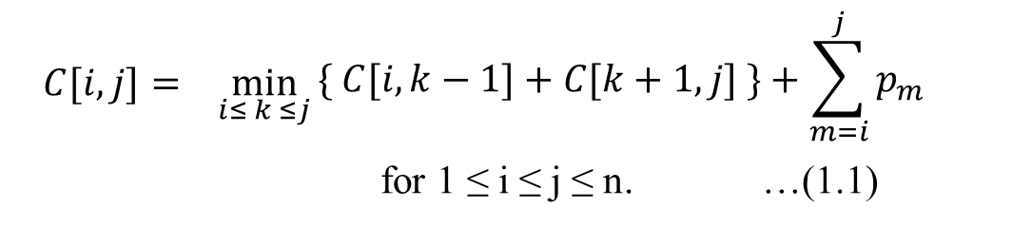
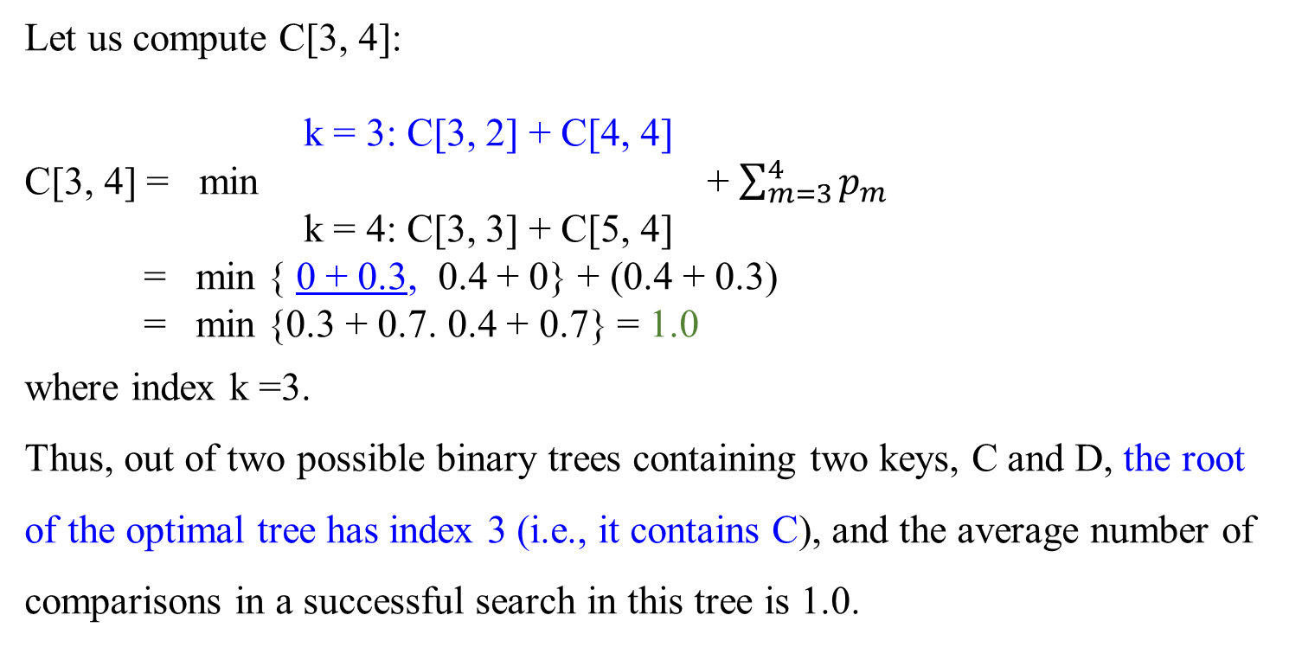
$$C[i, j]= \min_{i≤ k ≤j}{\begin{aligned}\{ C[i, k−1]+C[k+1,j] \}+\sum_{m=i}^{j}{p_{m}} \\ \end{aligned}}$$
for 1 ≤ i ≤ j ≤ n. …(1.1)
 | main table C
 | 0 | 1 | 2 | 3 | 4
1 | 0 | 0.1 | 0.4
2 |  | 0 | 0.2 | 0.8
3 |  |  | 0 | 0.4 | 1.0
4 |  |  |  | 0 | 0.3
5 |  |  |  |  | 0
Let us compute C[3, 4]:
k = 3: C[3, 2] + C[4, 4]
C[3, 4] = min + $\sum_{m=3}^{4}{p_{m}}$
k = 4: C[3, 3] + C[5, 4]
= min { 0 + 0.3, 0.4 + 0} + (0.4 + 0.3)
= min {0.3 + 0.7. 0.4 + 0.7} = 1.0
where index k =3.
Thus, out of two possible binary trees containing two keys, C and D, the root of the optimal tree has index 3 (i.e., it contains C), and the average number of comparisons in a successful search in this tree is 1.0.
C
D
B
D
C
1*0.4 + 2*0.3 = 1.0, or 0 + 0.3 + (0.4 + 0.3) = 1.0 …(1.1)
A
Key | A | B | C | D
Probability | 0.1 | 0.2 | 0.4 | 0.3

Slide 25
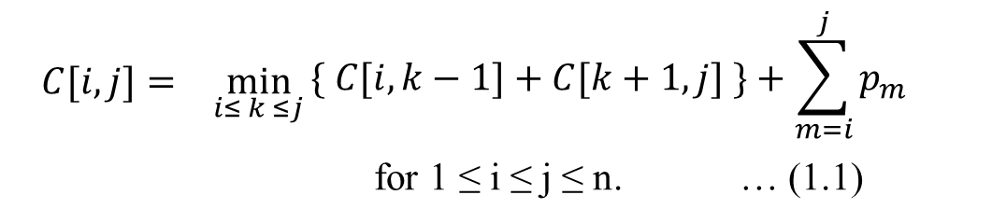
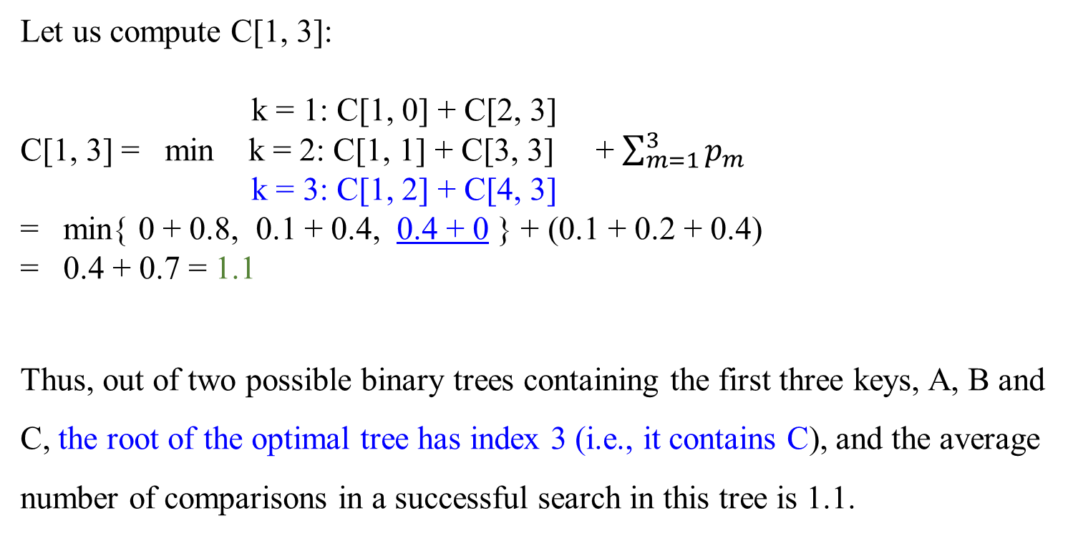
$$C[i, j]= \min_{i≤ k ≤j}{\begin{aligned}\{ C[i, k−1]+C[k+1,j] \}+\sum_{m=i}^{j}{p_{m}} \\ \end{aligned}}$$
for 1 ≤ i ≤ j ≤ n. … (1.1)
 | main table C
 | 0 | 1 | 2 | 3 | 4
1 | 0 | 0.1 | 0.4 | 1.1
2 |  | 0 | 0.2 | 0.8
3 |  |  | 0 | 0.4 | 1.0
4 |  |  |  | 0 | 0.3
5 |  |  |  |  | 0
Let us compute C[1, 3]:
k = 1: C[1, 0] + C[2, 3]
C[1, 3] = min k = 2: C[1, 1] + C[3, 3] + $\sum_{m=1}^{3}{p_{m}}$
k = 3: C[1, 2] + C[4, 3]
= min{ 0 + 0.8, 0.1 + 0.4, 0.4 + 0 } + (0.1 + 0.2 + 0.4)
= 0.4 + 0.7 = 1.1
Thus, out of two possible binary trees containing the first three keys, A, B and C, the root of the optimal tree has index 3 (i.e., it contains C), and the average number of comparisons in a successful search in this tree is 1.1.
C
B
D
1*0.4 + 2*0.2 + 3*0.1 = 1.1, or 0 + 0.4 + (0.1 + 0.2 + 0.4) = 1.1 …(1.1)
A
Key | A | B | C | D
Probability | 0.1 | 0.2 | 0.4 | 0.3

Slide 26
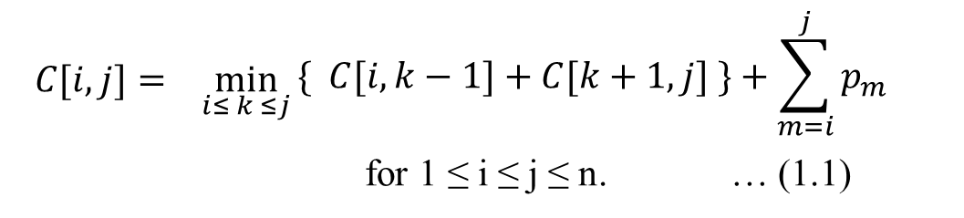
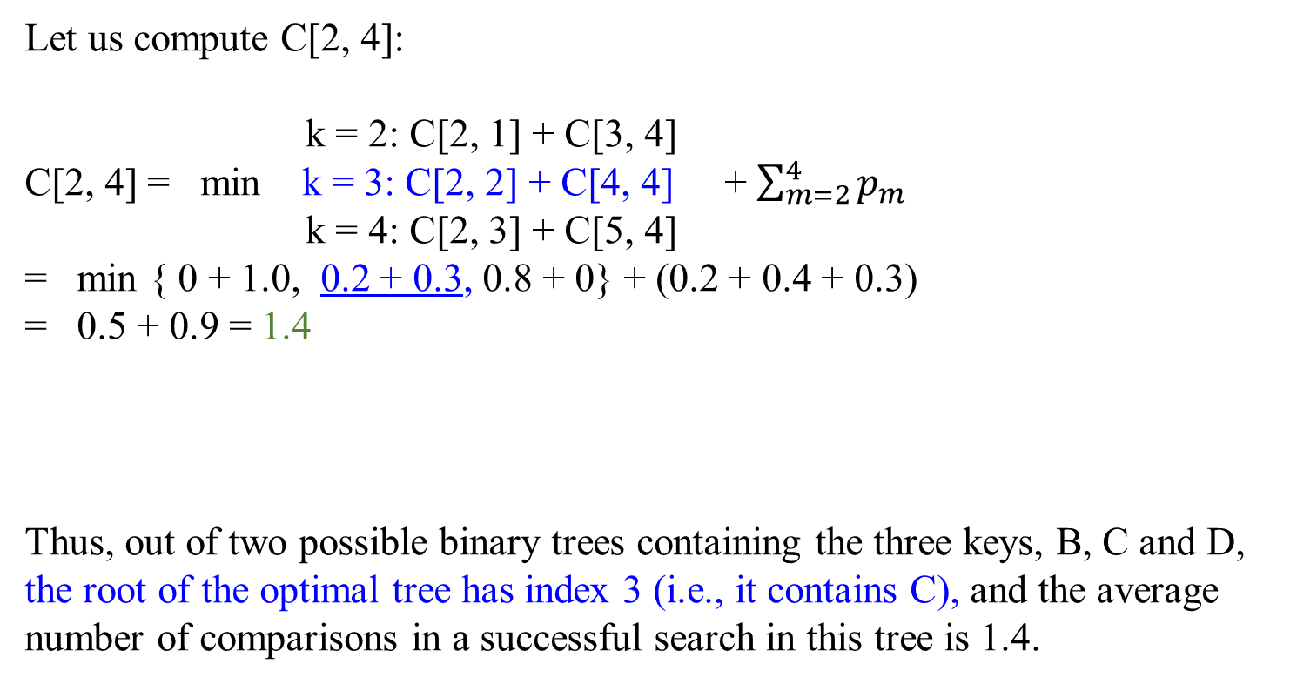
 | main table C
 | 0 | 1 | 2 | 3 | 4
1 | 0 | 0.1 | 0.4 | 1.1
2 |  | 0 | 0.2 | 0.8 | 1.4
3 |  |  | 0 | 0.4 | 1.0
4 |  |  |  | 0 | 0.3
5 |  |  |  |  | 0
$$C[i, j]= \min_{i≤ k ≤j}{\begin{aligned}\{ C[i, k−1]+C[k+1,j] \}+\sum_{m=i}^{j}{p_{m}} \\ \end{aligned}}$$
for 1 ≤ i ≤ j ≤ n. … (1.1)
Let us compute C[2, 4]:
k = 2: C[2, 1] + C[3, 4]
C[2, 4] = min k = 3: C[2, 2] + C[4, 4] + $\sum_{m=2}^{4}{p_{m}}$
k = 4: C[2, 3] + C[5, 4]
= min { 0 + 1.0, 0.2 + 0.3, 0.8 + 0} + (0.2 + 0.4 + 0.3)
= 0.5 + 0.9 = 1.4
Thus, out of two possible binary trees containing the three keys, B, C and D, the root of the optimal tree has index 3 (i.e., it contains C), and the average number of comparisons in a successful search in this tree is 1.4.
C
B
D
1*0.4 + 2*0.2 + 2*0.3 = 1.4, or 0.2 + 0.3 + (0.2 + 0.4 + 0.3) = 1.4 …(1.1)
A
Key | A | B | C | D
Probability | 0.1 | 0.2 | 0.4 | 0.3

Slide 27
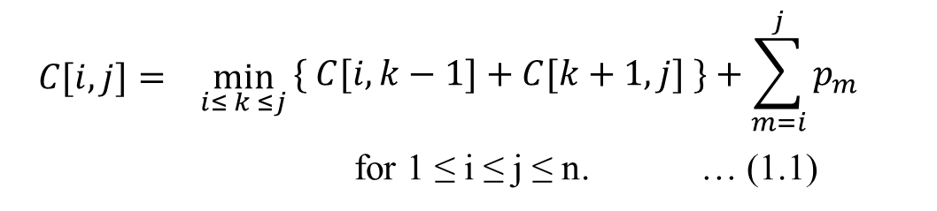
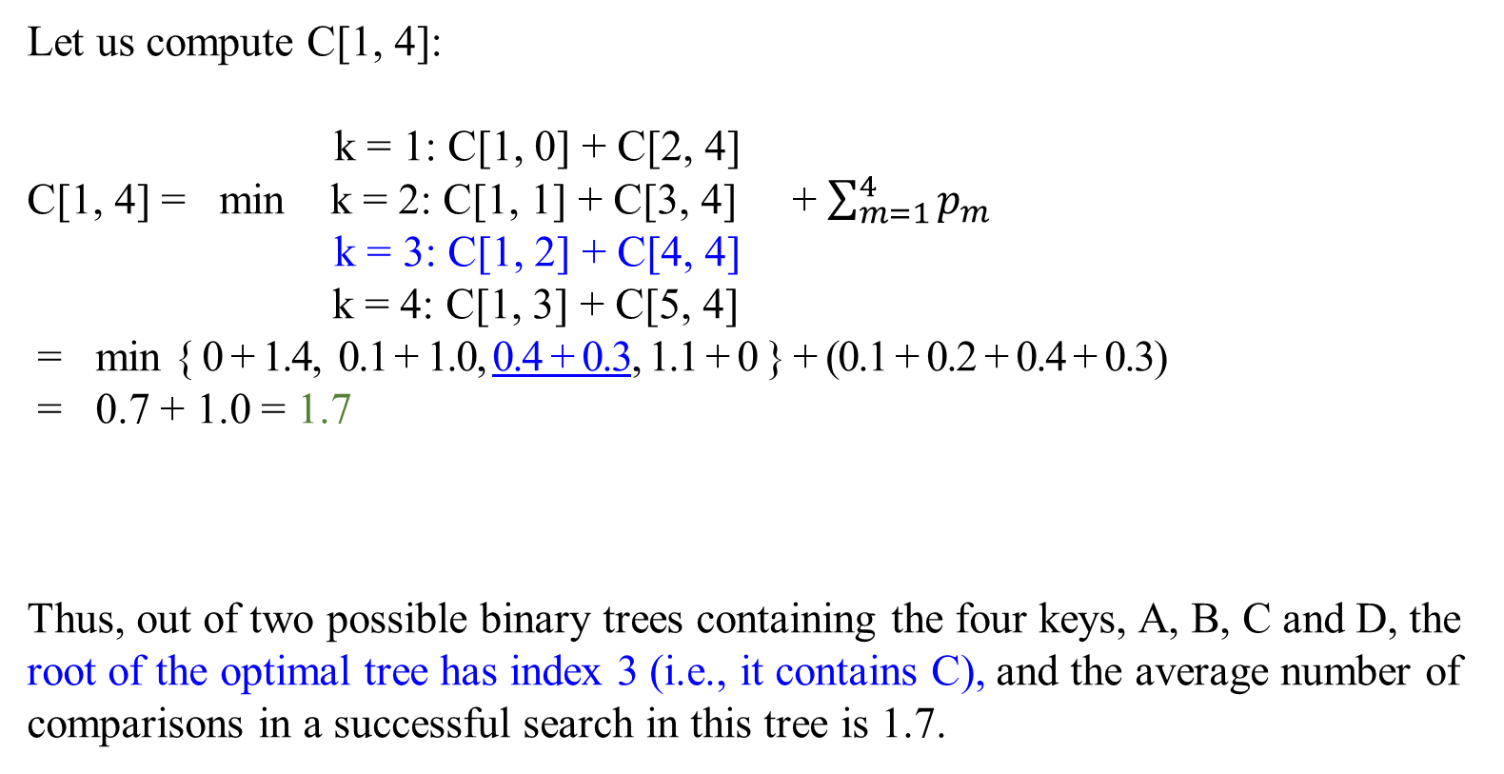
$$C[i, j]= \min_{i≤ k ≤j}{\begin{aligned}\{ C[i, k−1]+C[k+1,j] \}+\sum_{m=i}^{j}{p_{m}} \\ \end{aligned}}$$
for 1 ≤ i ≤ j ≤ n. … (1.1)
 | main table C
 | 0 | 1 | 2 | 3 | 4
1 | 0 | 0.1 | 0.4 | 1.1 | 1.7
2 |  | 0 | 0.2 | 0.8 | 1.4
3 |  |  | 0 | 0.4 | 1.0
4 |  |  |  | 0 | 0.3
5 |  |  |  |  | 0
Let us compute C[1, 4]:
k = 1: C[1, 0] + C[2, 4]
C[1, 4] = min k = 2: C[1, 1] + C[3, 4] + $\sum_{m=1}^{4}{p_{m}}$
k = 3: C[1, 2] + C[4, 4]
k = 4: C[1, 3] + C[5, 4]
= min { 0 + 1.4, 0.1 + 1.0, 0.4 + 0.3, 1.1 + 0 } + (0.1 + 0.2 + 0.4 + 0.3)
= 0.7 + 1.0 = 1.7
Thus, out of two possible binary trees containing the four keys, A, B, C and D, the root of the optimal tree has index 3 (i.e., it contains C), and the average number of comparisons in a successful search in this tree is 1.7.
C
B
D
A
Key | A | B | C | D
Probability | 0.1 | 0.2 | 0.4 | 0.3

Slide 28
The result of completing computations should arrive at the following final tables :
 | main table
 | 0 | 1 | 2 | 3 | 4
1 | 0 | 0.1 | 0.4 | 1.1 | 1.7
2 |  | 0 | 0.2 | 0.8 | 1.4
3 |  |  | 0 | 0.4 | 1.0
4 |  |  |  | 0 | 0.3
5 |  |  |  |  | 0
 | root table
 | 0 | 1 | 2 | 3 | 4
1 |  | 1 | 2 | 3 | 3
2 |  |  | 2 | 3 | 3
3 |  |  |  | 3 | 3
4 |  |  |  |  | 4
5
Thus, the average number of key comparisons in the optimal tree is equal to 1.7. Since R[1, 4] = 3, the root of the optimal tree contains the third key, i.e., C.
Its left subtree is made up of keys A and B, and its right subtree contains just key D (why?).

Slide 29
To find the specific structure of these subtrees, we find first their roots by consulting the root table again as follows.
Since R[1, 4] = 3, the root of the optimal tree contains the third key, i.e., C. Its left subtree is made up of keys A and B, and its right subtree contains just key D
Since R[1, 2] = 2, the root of the optimal tree containing A and B is B, with A being its left child (and the root of the one-node tree: R[1, 1] = 1).
Since R[4, 4] = 4, the root of this one-node optimal tree is its only key D. Figure 6.5.5 presents the optimal tree in its entirety.
C
 | root table
 | 0 | 1 | 2 | 3 | 4
1 |  | 1 | 2 | 3 | 3
2 |  |  | 2 | 3 | 3
3 |  |  |  | 3 | 3
4 |  |  |  |  | 4
5
B
D
A
Figure 6.5.5. Optimal binary search tree for the example.

Slide 30
The optimal search time is 0.4*1 + 0.2*2 + 0.1*3 + 0.3*2 = 1.7
 | root table
 | 0 | 1 | 2 | 3 | 4
1 |  | 1 | 2 | 3 | 3
2 |  |  | 2 | 3 | 3
3 |  |  |  | 3 | 3
4 |  |  |  |  | 4
5
0.4
C
0.2
B
0.1
D
0.3
A
Figure 6.5.5 Optimal binary search tree for the example.

Slide 31
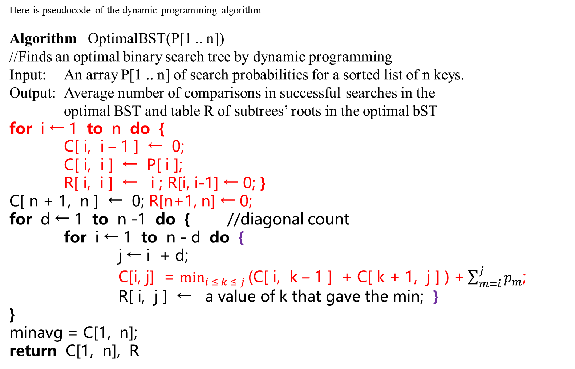
Here is pseudocode of the dynamic programming algorithm.
Algorithm OptimalBST(P[1 .. n])
//Finds an optimal binary search tree by dynamic programming
Input: An array P[1 .. n] of search probabilities for a sorted list of n keys.
Output: Average number of comparisons in successful searches in the
optimal BST and table R of subtrees’ roots in the optimal bST
for i ← 1 to n do {
C[ i, i – 1 ] ← 0;
C[ i, i ] ← P[ i ];
R[ i, i ] ← i ; R[i, i-1] ← 0; }
C[ n + 1, n ] ← 0; R[n+1, n] ← 0;
for d ← 1 to n -1 do { //diagonal count
for i ← 1 to n - d do {
j ← i + d;
C[i, j] = $\min_{i ≤ k ≤ j}{\text{(}\text{C}\text{[ }\text{i}\text{, }\text{k} \text{–}\text{ 1 ] + }\text{C}\text{[ }\text{k}\text{ + 1, }\text{j}\text{ ] ) +}}\sum_{m=i}^{j}{p_{m}}$;
R[ i, j ] ← a value of k that gave the min; }
}
minavg = C[1, n];
return C[1, n], R

Slide 32
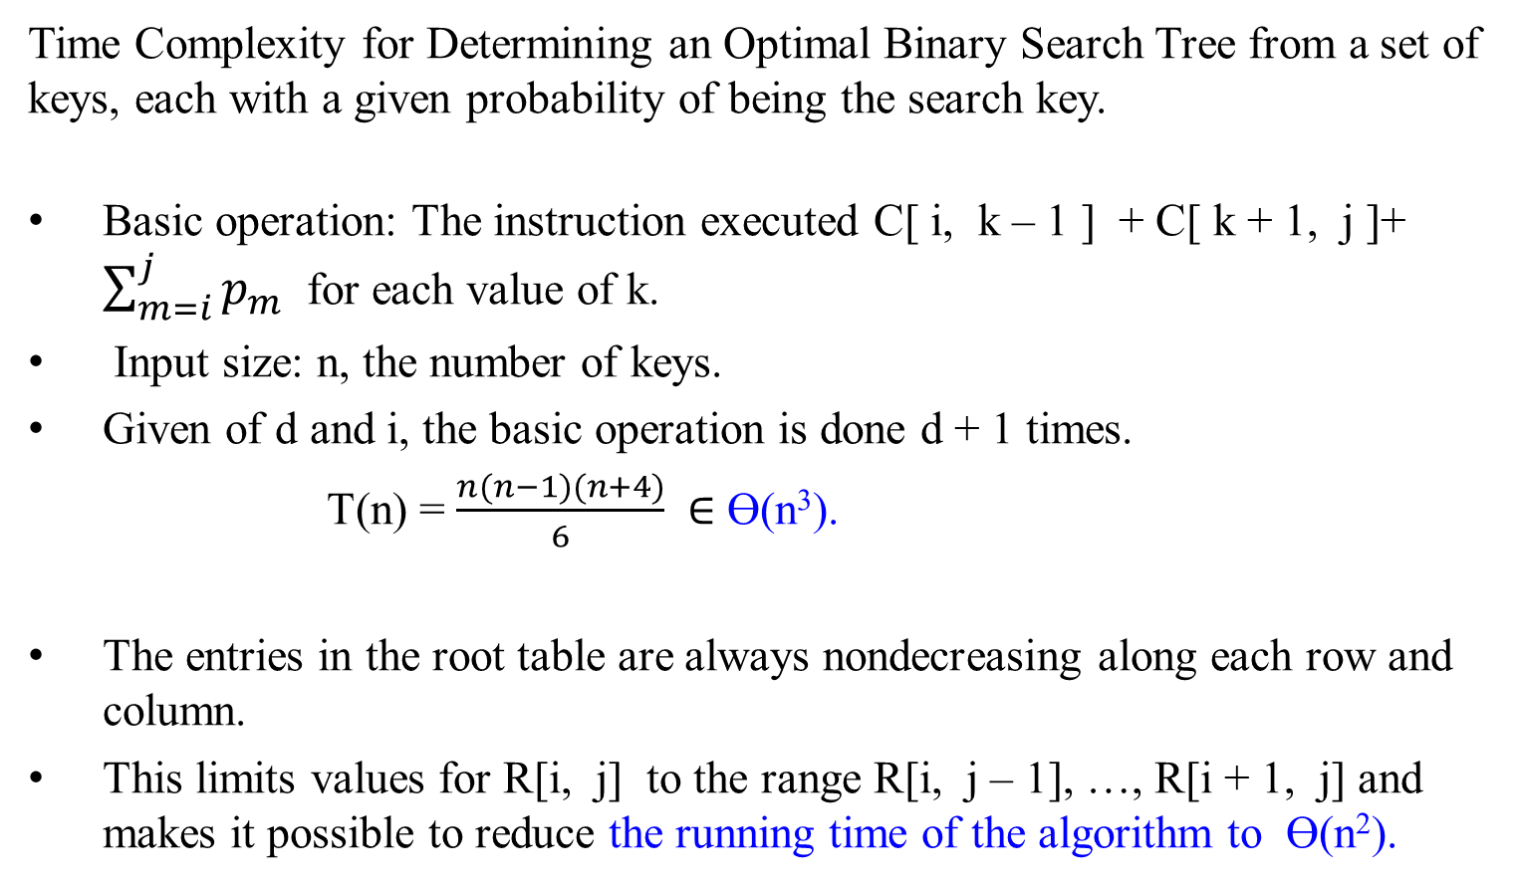
Time Complexity for Determining an Optimal Binary Search Tree from a set of keys, each with a given probability of being the search key.
Basic operation: The instruction executed C[ i, k – 1 ] + C[ k + 1, j ]+ $\sum_{m=i}^{j}{p_{m}}$ for each value of k.
Input size: n, the number of keys.
Given of d and i, the basic operation is done d + 1 times.
T(n) = $\frac{n(n−1)(n+4)}{6} ∈$ ϴ(n³).
The entries in the root table are always nondecreasing along each row and column.
This limits values for R[i, j] to the range R[i, j – 1], …, R[i + 1, j] and makes it possible to reduce the running time of the algorithm to ϴ(n²).

Slide 33
Here is pseudocode of the dynamic programming algorithm. (details for executing formula (1.1))
Algorithm OptimalBST(P[1 .. n])
//Finds an optimal binary search tree by dynamic programming
Input: An array P[1 .. n] of search probabilities for a sorted list of n keys.
Output: Average number of comparisons in successful searches in the
optimal BST and table R of subtrees’ roots in the optimal bST
for i ← 1 to n do {
C[ i, i – 1 ] ← 0;
C[ i, i ] ← P[ i ];
R[ i, i ] ← i ;}
C[ n + 1, n ] ← 0;
for d ← 1 to n -1 do { //diagonal count
for i ← 1 to n - d do {
j ← i + d;
minval ← ∞;
for k ← i to j do {
if C[ i, k – 1 ] + C[ k + 1, j ] < minval
then { minval ←C[ i, k – 1 ] + C[ k + 1, j ] ; kmin ← k }
}
R[ i, j ] ← kmin ;
sum ← P[ i ];
for m ← i + 1 to j do { sum ← sum + P[ m ] }
C[ i, i ] ← minval + sum; }
}
return C[1, n], R

Slide 34
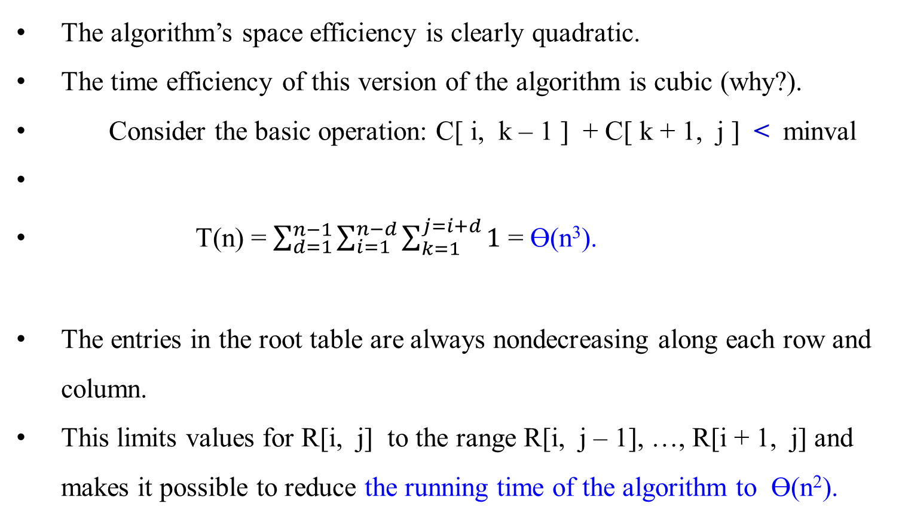
The algorithm’s space efficiency is clearly quadratic.
The time efficiency of this version of the algorithm is cubic (why?).
Consider the basic operation: C[ i, k – 1 ] + C[ k + 1, j ] < minval
T(n) = $\sum_{d=1}^{n−1}{\sum_{i=1}^{n−d}{\sum_{k=1}^{j=i+d}{1}}}$ = ϴ(n³).
The entries in the root table are always nondecreasing along each row and column.
This limits values for R[i, j] to the range R[i, j – 1], …, R[i + 1, j] and makes it possible to reduce the running time of the algorithm to ϴ(n²).

Slide 35
Chapter 06_06 Dynamic Programming The Knapsack Problem and Memory Function

